Slide 1
Naming Ionic Compounds

Slide 2
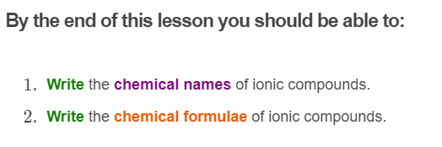


Slide 3

The names of ionic compounds are easy to write: you simply write the names of the ions that make them up.
For example, the chemical name of fluorite is calcium fluoride. It is made up of calcium ions and fluoride ions.

Slide 4
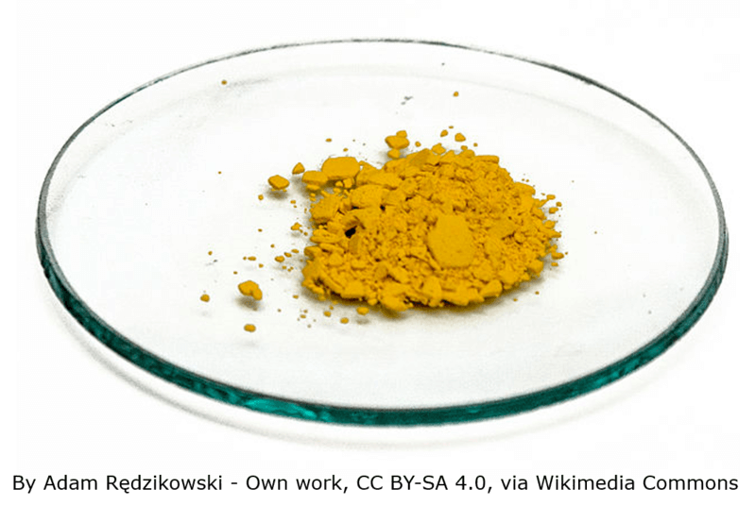
When you are naming an ionic compound, you must always put the positive ion first and the negative ion second.
For example, an ionic compound made up of lead (Pb²⁺) and iodide (I⁻) is called lead iodide and not iodide lead.

Slide 5
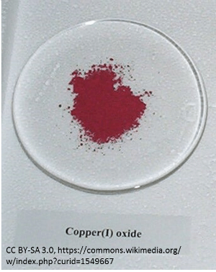
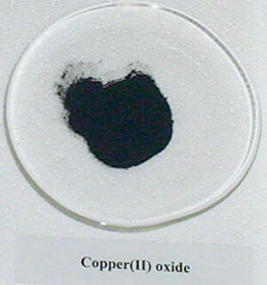
If you are writing the name of an ionic compound containing ions that require Roman numerals to identify their charge, the Roman numerals must be included.
This lets other people know what the chemical formula is. For example, copper (I) and copper (II) ions both form compounds with oxide ions. Copper (I) oxide has the chemical formula Cu₂​O while copper (II) oxide has the chemical formula CuO. You will learn more about chemical formulae soon.

Slide 6
Writing the chemical formulae of ionic compounds is similar to writing their name, but instead of writing words you use the chemical symbols!
There are also a few extra rules you need to follow when writing chemical formulae.

Slide 7
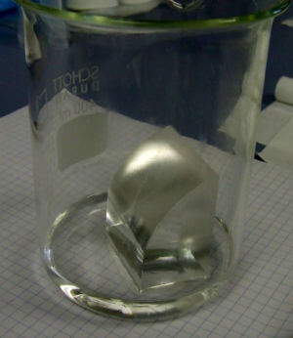
Similar to writing the name of an ionic compound, when writing the chemical formula the positive ion is always written first and the negative ion is always written second.
The charges on the ions are not written in the chemical formula.
For example, the compound formed from Li⁺ and F⁻ ions is called lithium fluoride. Its chemical formula is written LiF.

Slide 8
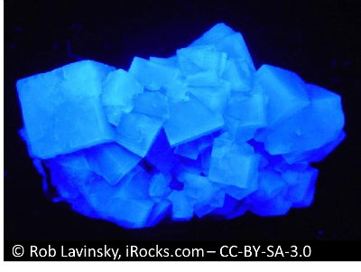
The overall charge on an ionic compound must always be zero.
This means that if the charges on the ions that make up the compound are different, there must be more of one type of ion than the other to balance the charges.
For example, calcium ions have a charge of +2, while fluoride ions have a charge of −1. If there was only one Ca²⁺ ion and one F− ion, the overall charge would be +1. There must be two F− ions and one Ca²⁺ ion in calcium fluoride to balance the charge.

Slide 9
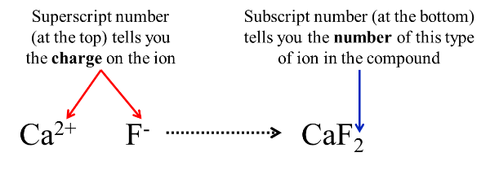
Use the ionic charges to determine how many of each ion is needed to make a neutrally charged ionic compound.
The ionic formula for calcium fluoride is CaF₂​. The subscript 2 tells you that there are 2 fluoride ions. If there is no subscript number it tells you that there is only one of these ions.

Slide 10

To figure out what the chemical formula for an ionic compound will be, you first need to determine the charge on the ions that make it up.
You then need to determine how many of each type of ion are needed to make the overall compound neutral.
The easiest way to do this is to use the swap and drop method.

Slide 11
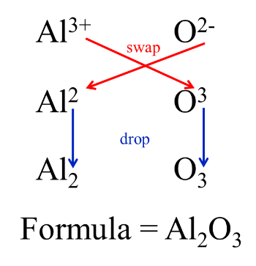
The swap and drop method involved swapping the numbers from the charges on the ions and then dropping these numbers to give you the number of each type of ion in the compound.
Putting these together then gives you the ionic formula.
For example, the ionic compound aluminium oxide is made up of Al³⁺ and O²⁻ ions. Its ionic formula is Al₂​O_{3​}. This gives 6 positive charges and 6 negative charges to make the overall compound neutral.

Slide 12
The final step is to determine whether the numbers can be divided by a common factor.
If they can, divide both numbers by the common factor.
For example, magnesium oxide is made up of Mg²⁺ ions and O²⁻ ions. If you were to swap and drop the numbers, it would give you the formula Mg₂​O₂​, but this is not correct. Both numbers can be divided by 2 to give the correct formula, MgO.

Slide 13


